Slide 1
Review
TBC New Member Education 2021

Slide 2
Accounting
Know basic terms on the three statements (ex: What does shareholder’s equity mean, what is EBITDA, what is gross profit)
Be able to do three statement problems
Know intuition behind solvency ratios, liquidity ratios, etc.

Slide 3
Question 1: Standard
Period One: You purchase $20 of inventory with debt.
Period Two: You sell the inventory for $30. Ignore the interest rate on the debt you took. Assume a 20% tax rate.

Slide 4
Question 1: Answer
Period One:
IS: No effect because you have not delivered any goods yet.
CF: Inventory is a current asset which means your working capital has increased. This causes cash to go down by 20.
BS: Cash is up 20 and down 20 because you raised debt to get cash and spent it (0 net change), inventory up 20 in current assets, debt is up 20 in liabilities.
Period Two:
IS: Revenue +30, COGS is 20 expense so -20, Gross profit is 10, Tax expense is 2. NI: +8
CF: Start with +8 in CFO, then add back 20 because of working capital decrease, Cash: +28
BS: Inventory down 20, Cash up 28, Shareholder’s equity up 8

Slide 5
Question 2: A bit harder
You sell your customer a streaming subscription worth $240. You get paid the $240 upfront, but you deliver the service over the course of a year. Every month you can assume you deliver 1/12 of the service. What happens in your three statements initially and after one month?
Assume 20% tax rate

Slide 6
Question 2: Answer
Month Zero:
IS: No effect
CF: Cash up 240
BS: Assets: Cash up 240, Liabilities: Up 200 from deferred revenue liability
One Month:
IS: Revenue up $20, Post tax NI is up 16
CF: CFO: Start with +16, subtract out 20 because your deferred revenue liability has decreased, this is a working capital outflow
BS: Assets: Cash -4, L: -20, SE: +16

Slide 7
Competitive strategy
Know Porter’s Five Forces reading
Be comfortable arguing that a company is “high quality”
Be concise
Understand ROIC and know how to calculate all the returns (ROE, ROA, ROIC etc)
Know all the economic moats
Understand the concept of an economic profit

Slide 8
Example
Do you think new discount airlines will succeed in the long term?
Out of the following businesses, which do you think has the strongest competitive advantages?
Trader Joes
Ikea
Moderna

Slide 9
Valuation
Understand the formula for terminal value
Understand the multiples and what they may infer
Be comfortable with the concepts of cost of debt and equity
Know what FCF formula is and understand net working capital

Slide 10
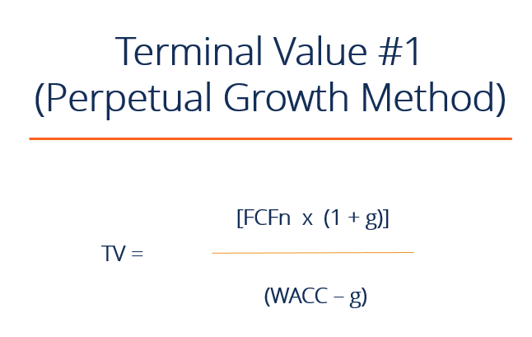
Terminal Value Formula
The (1+g) is taking us to next year. Next year is the start of our infinite period. The terminal value is calculating the value of cash flows form year 6-infinity if we forecasted out 5 years of FCF

Slide 11
Multiples Questions
Why might two companies in the same industry with the same growth rate trade at a different multiples?
Why might someone prefer using multiples with EV in the numerator?
Why might we not want to use ____ multiple?
Company A trades at 5x EV/Revenue and 50x EV/EBIT
Company B trades at 10x EV/Revenue and 20x EV/EBIT
Why might this be the case?

Slide 12
Multiples Answers
Why might two companies in the same industry with the same growth rate trade at a different multiples?
Reinvestment rate or WACC
Why might someone prefer using multiples with EV in the numerator?
Unaffected by capital structure
Why might we not want to use ____ multiple?
Think about what that multiple is excluding
Company A trades at 5x EV/Revenue and 50x EV/EBIT
Company B trades at 10x EV/Revenue and 20x EV/EBIT
Why might this be the case?
Company A has a lower EV/EBITDA margin

Slide 13
Pitches
Checking to make sure you paid attention during our pitches
Can find all the pitches through Grace’s emails
You should know all the companies pitched at a high level. Helpful to know a few of the pitches in a bit more detail

